Slide 1
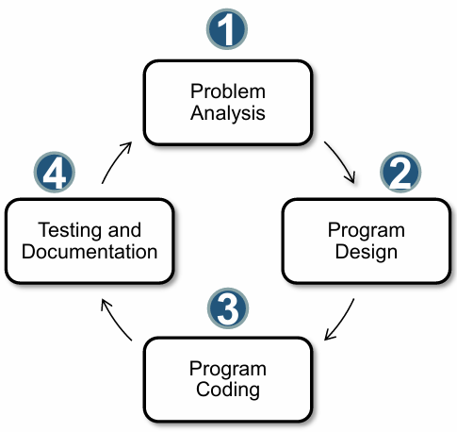
Analyzing the problem which is how to manage the education recourses. The problem was mainly that data are available, but they are not easy to access and students stuck searching for them.
We think how we can make it easier and then we make a flowchart and a pseudocode on how the website is going to be.
We worked in the code for each page.
We test the site and make sure that it is working without any errors.

Slide 2
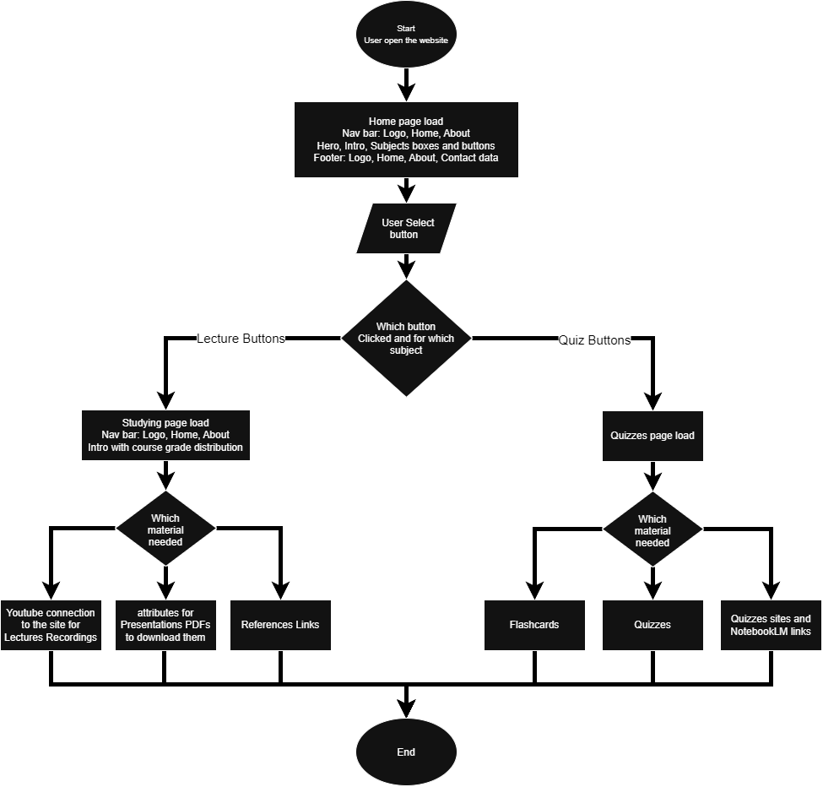
Start
Load Home page code
If button Selected == quizzes then
Load Quizzes page for this subject
if material == Flashcards then
Start Flashcards
elseif material == Quizzes then
Run Quiz and timer
else
Quizzes sites links
endif
Else
Load Lectures page for this subject
if material == Videos then
open videos
elseif material == PDFs then
download PDFs
else
References Links
endif
Endif
End

